Slide 1
Data-Driven Analysis of Rental Housing Stress: Regina and Saskatoon
Name : Shubham Mineshkumar Gandhi
Course : CS719 – Data Science Project
Date : 04 – 21 – 2026
Student ID: 200526729
Instructor: Dr. Howard Hamilton
Notes:
Good evening everyone, My name is Shubham Gandhi, and Today I’ll be presenting my project on A Data-Driven Analysis of Rental Housing Stress in Regina and Saskatoon.
First of all, thank you Dr. Hamilton for providing us this opportunity to present our work, in front of such great minds.
This project focuses on measuring and analyzing rental housing affordability using a structured, data-driven approach.”

Slide 2
Outline
1
Problem Statement & Motivation
Data sources
Methodology
Housing Stress Model & Risk Classification
Dashboard Demonstration
Future Work
Notes:
In this presentation I will cover:
the problem statement that encouraged to work on this topic,
Followed by data sources and methodology, used to accomplish this project
Then after, I’ll briefly explain housing stress Model, and risk classification approach.
After that, I will demonstrate the results and insights using interactive dashboards, and
Finally, conclude with future work

Slide 3


Problem Statement & Motivation
2
Problem:
1. Rental housing affordability is worsening across
Canadian cities.
2. Rent is increasing faster than income.
3. Single-person households face higher vulnerability.
Goal:
Develop a Housing Stress Score Model and classify risk
levels across zones in Regina and Saskatoon, to support
data-driven decision-making for policy makers and town-planners.
Motivation:
There is a Lack of a clear, data-driven metrics to measure housing stress
Source: Link
Notes:
Rental Housing affordability is becoming a major concern across Canadian cities.
rental costs are rising faster than household incomes, which increases financial pressure on households.
Among all groups, single-person households are the most vulnerable, but obviously they are dependent on a single income source.
(click)
The key problem is: policymakers often lack standardized, data-driven framework to measure housing stress.
(click)
So the goal of this project, is to develop a Housing stress score model and classify zones into different risk levels. This allows reliable decision making for policymakers and urban planners.

Slide 4
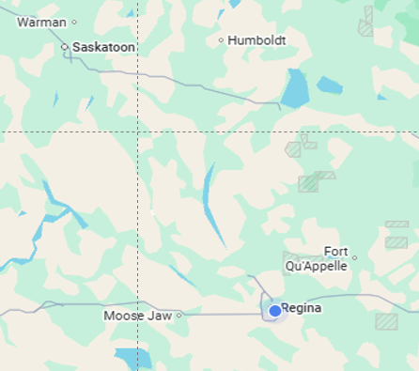
Data Sources
3
Dataset | Source
Rental Data | CMHC Rental Market Data
Household Income Data | Census 2011, 2016, 2021
Provincial Income Growth Rate | Statistics Canada
Data Period: 2011-2023
Geographical Area Covered:
1. Regina (CMA)
2. Saskatoon (CMA)
CMA – Census Metropolitan Area
CMHC – Canada Mortgage and
Housing Corporation
Source: Link
Notes:
This project uses 3 main data sources:
CMHC Rental Market Data, from which I retrieved all rental based information such as avg monthly rent, vacancy rates and no of apts .
Census data, from where I income specific metrices.
Since income data was only available for these census years: 2011, 2015 and 2020, I estimated the data for the remaining years using provincial income growth rates from Statistics Canada.
Click
This results in an overall dataset range from 2011 to 2023
Click
This analysis focuses on 2 cities – Regina, and Saskatoon – at the CMA level.

Slide 5
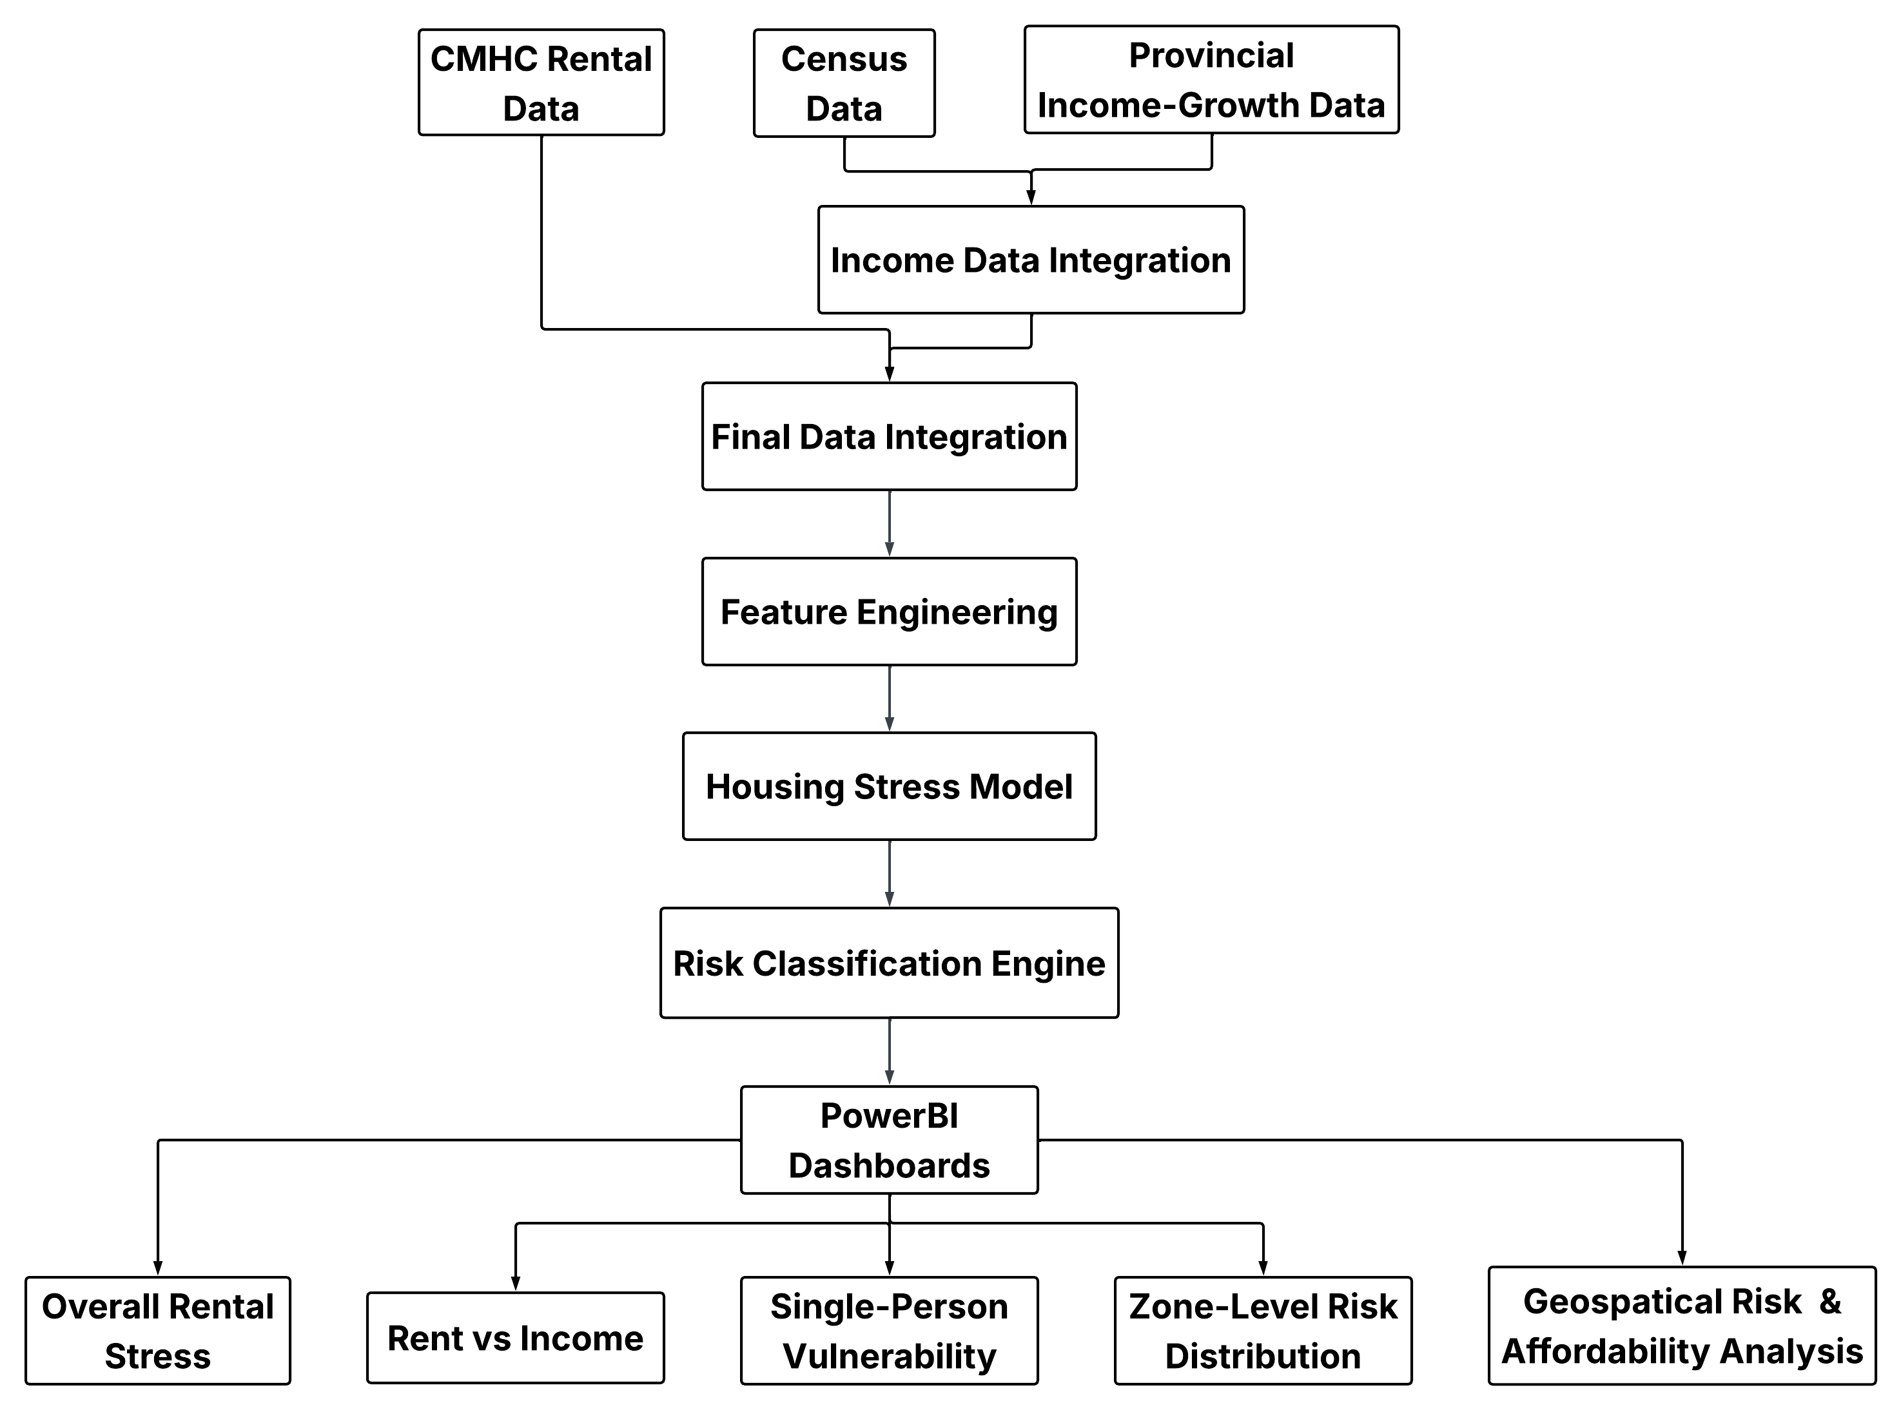
Methodology
4
Step 1
Step 2
Step 3
Step 4
Step 5
Source: Lnk
Notes:
Step 1: Collect rental and income data, and performing data preparation
Step 2: Integrate income data across years.
Step 3: focuses on complete data integration and feature engineering.
Step 4: involves developing the housing stress model, performing risk classification
Step 5: finally I have used Power BI dashboards, for showcasing my results and insights.

Slide 6



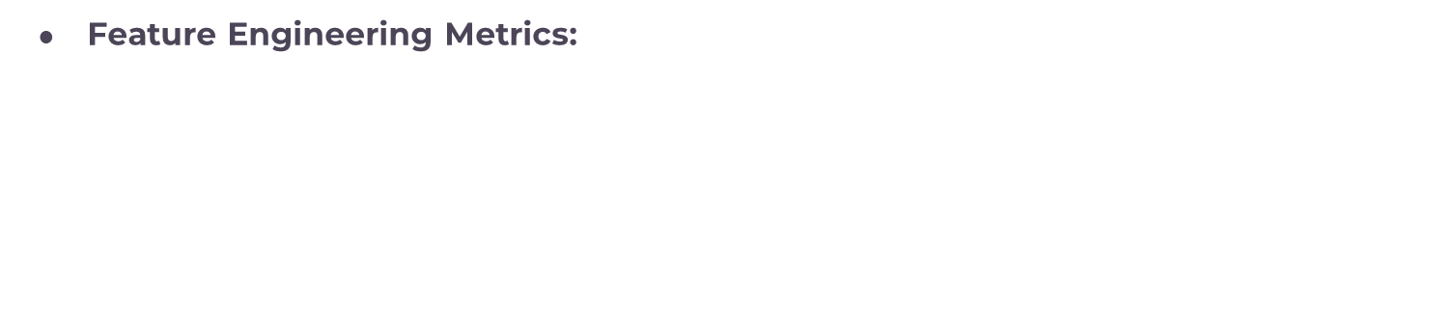
Housing Stress Score Model
5
Feature Engineering Metrics:
Housing Stress Score:
$$RTI = Rent−To−Income Ratio$$
$$SPV= Single Person Vulnerability$$
$II = Income Inequality$
$TI = Tax Impact$
Notes:
The housing stress score is calculated using 4 engineered features
These includes:
RTI = Rent-to-Income Ratio
SPV = Single-person vulnerability
II = Income Inequality
TI = Tax impact
All these mentioned features are normalized using min-max normalization technique, to bring them all on a same scale
click
The final Stress Score is a weighted sum, where higher values indicate greater stress.
This approach ensures that all relevant economic factors are considered together rather than relying on a single metric.

Slide 7
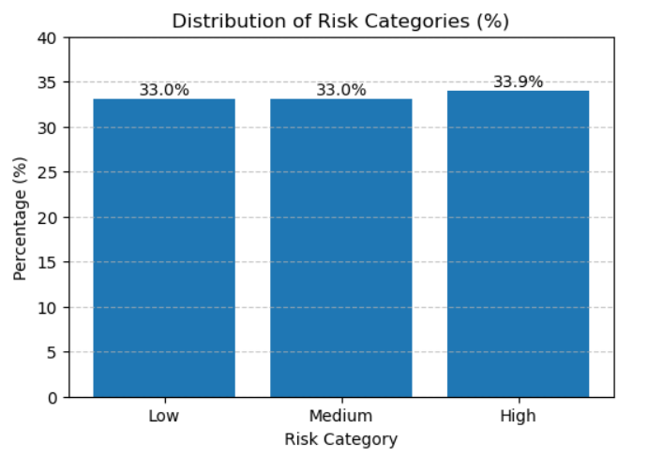
Risk Classification Engine
6
Risk Categorization Rules:
Low Risk: Stress Score <= 0.37
Medium Risk: 0.37 < Stress Score <= 0.52
High Risk: Stress Score > 0.52
(Thresholds are derived using
Quantile-based approach)
Interpretation:
Higher stress score = Higher rental stress
Use Case:
Identifies vulnerable zones for policy
focus
Notes:
Based on the housing stress score computed, each zone is classified into three risk categories: Low, Medium, and High
These categories are defined using thresholds:
Low risk: if the stress score is less than or equal to 0.37
Medium risk: if the score is between 0.38 to 0.52
High risk: if the stress exceeds: 0.52
The chart shows that the distribution is balanced across categories, which ensures fair comparison across zones.

Slide 8
7
Dashboard Demonstration
Exploring trends, vulnerabilities, and zone-level risk patterns
Notes:
Now we are equipped with almost all essential information which require us to understand the dashboards in a more meaningful way

Slide 9

Future Work
8
1. Expand Analysis to more cities and
regions.
2. Incorporate additional socio-economic
factors.
3. Enable real-time dynamic dashboards
4. Explore policy impact simulation.
5. Develop advanced forecasting models for
future trends based on socio-economic
dashboards.
Notes:
This project has a strong potential and planning to take this project to the next level.
read:
right now, the project covered only regina and saskatoon, but planning to cover entire province, and eventually whole country.
2. read:
inflation/cost of living, employment rates, migration trends
3. Read
Connecting with live data sources, enabling continuous monitoring for policymakers
4. Read
Rent control
Income subsidies
Housing supply changes
5. Read
Weight optimization techniques instead of fixed weights

Slide 10
9
Questions ?
Thank you…

